Slide 1

Connecting With SQLite Database
A step-by-step guide for students learning how to integrate SQLite into a Deno web application — from installation to displaying live data.

Slide 2
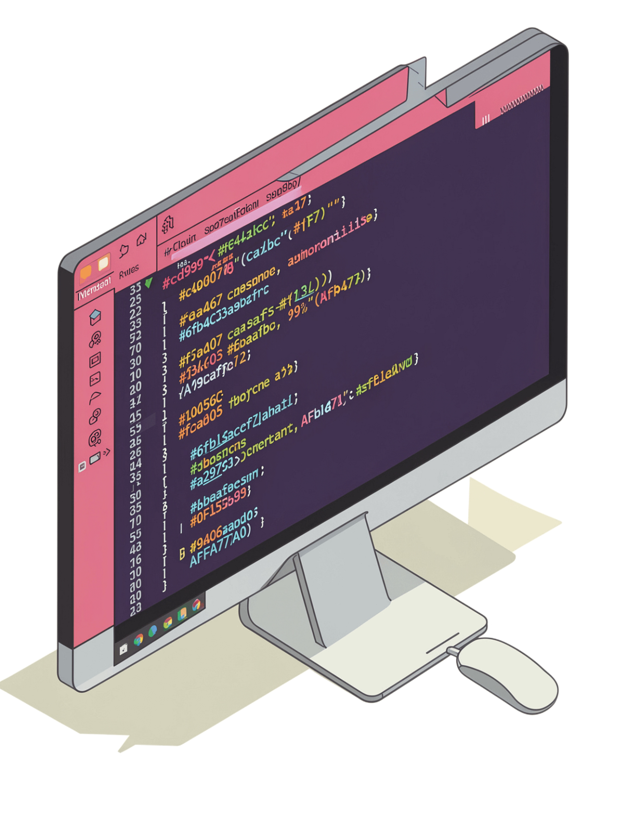
Step 1: Install SQLite Package
Open the Visual Studio terminal and run the following command to add the SQLite dependency to your Deno project:
What it does
Adds the SQLite dependency to your project configuration
deno add jsr:@db/sqlite
This registers the @db/sqlite package from the JSR registry and makes it available throughout your project.
Where to run it
In the integrated terminal inside Visual Studio Code

Slide 3
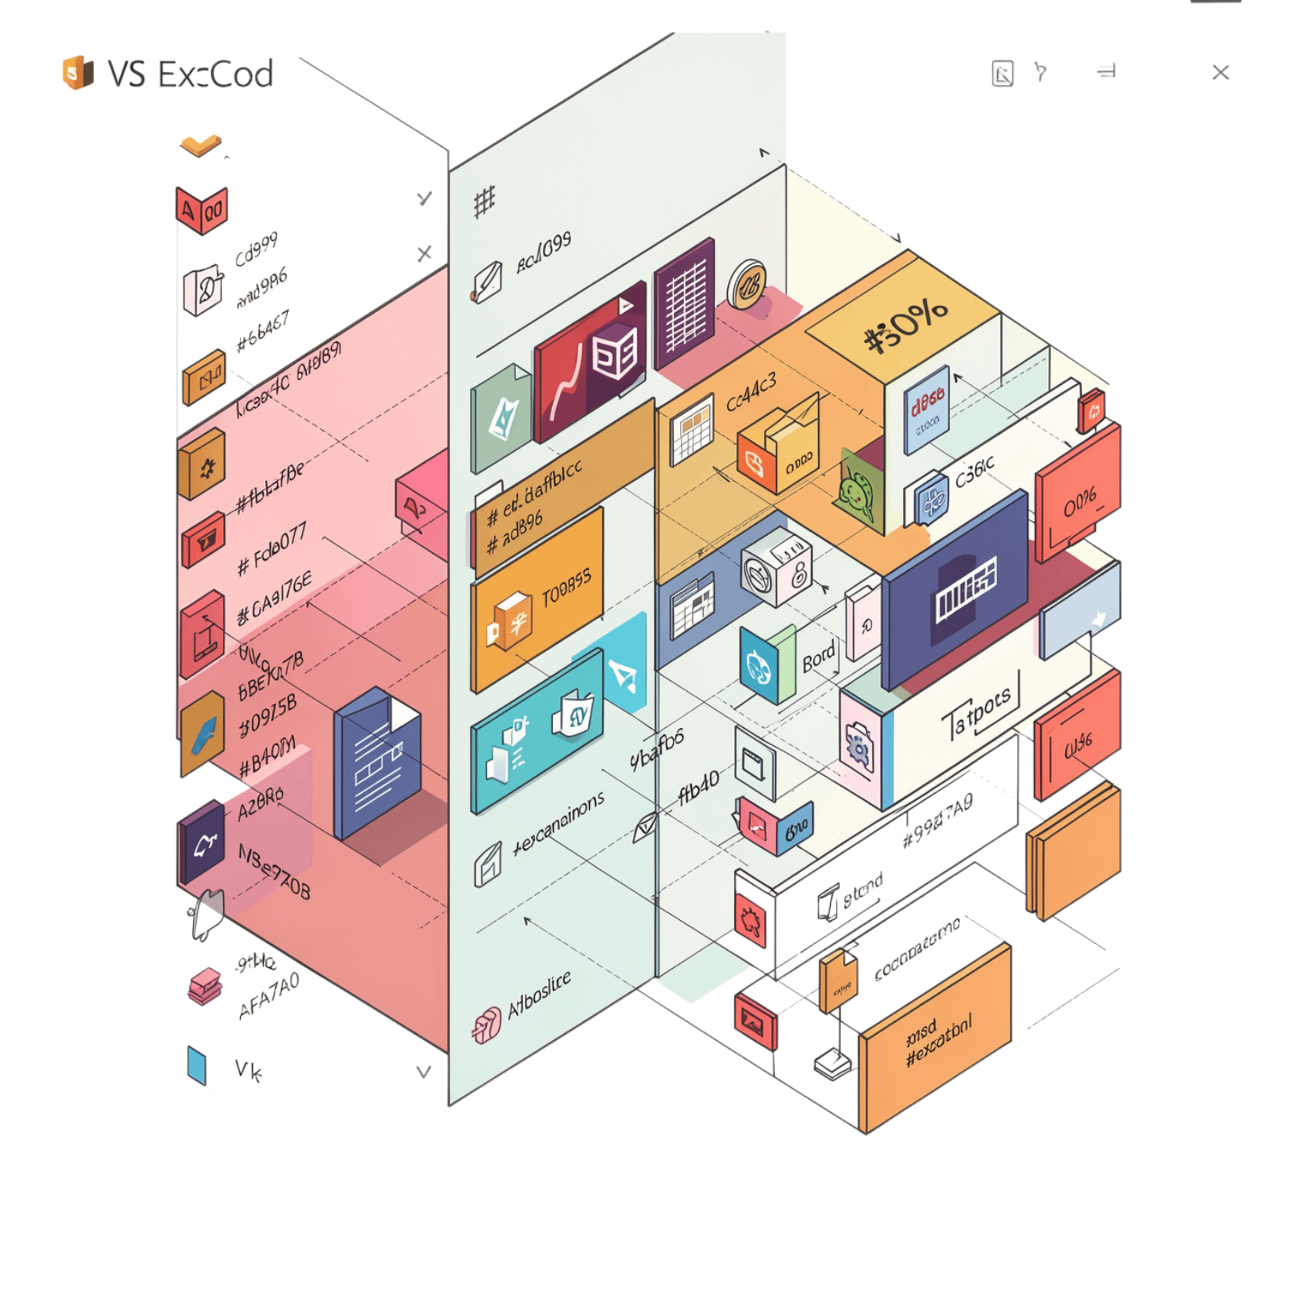

Step 2: Install SQLite Extension
Navigate to the Extensions panel in Visual Studio Code and search for the SQLite extension.
Provides database management tools directly inside your IDE
Allows you to browse, query, and inspect your .db files visually
Makes debugging your database much easier during development
Installing this extension is not required to run your app, but it is highly recommended for inspecting your database during development.

Slide 4
Step 3: Create db.js File
Inside your app folder, create a new file called db.js. This file will import the Database class and export a shared database connection that the rest of your app can use.
import { Database } from "@db/sqlite";
export const db = new Database('studentsDB.db');
Import
Initialize
Export
Bring in the Database class from the installed @db/sqlite package
Create a new Database instance pointing to studentsDB.db
Export db so every module in your app shares the same connection

Slide 5
Step 4: Create Database Schema
In app/tasks, create db-create.js. This script drops any existing table, creates a fresh students table, and inserts two sample records.
import { db } from "../db.js";
db.exec(`
DROP TABLE IF EXISTS students;
CREATE TABLE students (
id INTEGER PRIMARY KEY AUTOINCREMENT,
name TEXT NOT NULL,
phone TEXT,
email TEXT,
program TEXT,
country TEXT
);
INSERT INTO students (name, phone, email, program, country) VALUES
('Sudarshan', '+1234567',
'abc@example.com',
'Computer Science', 'Nepal'),
('Mahadi', '+1234567',
'Mahadi@example.com',
'Computer Science', 'Bangladesh');
`);
TABLE COLUMNS
1
2
3
id
name, phone, email
program, country
INTEGER PRIMARY KEY AUTOINCREMENT
TEXT fields for contact info
TEXT fields for academic info

Slide 6
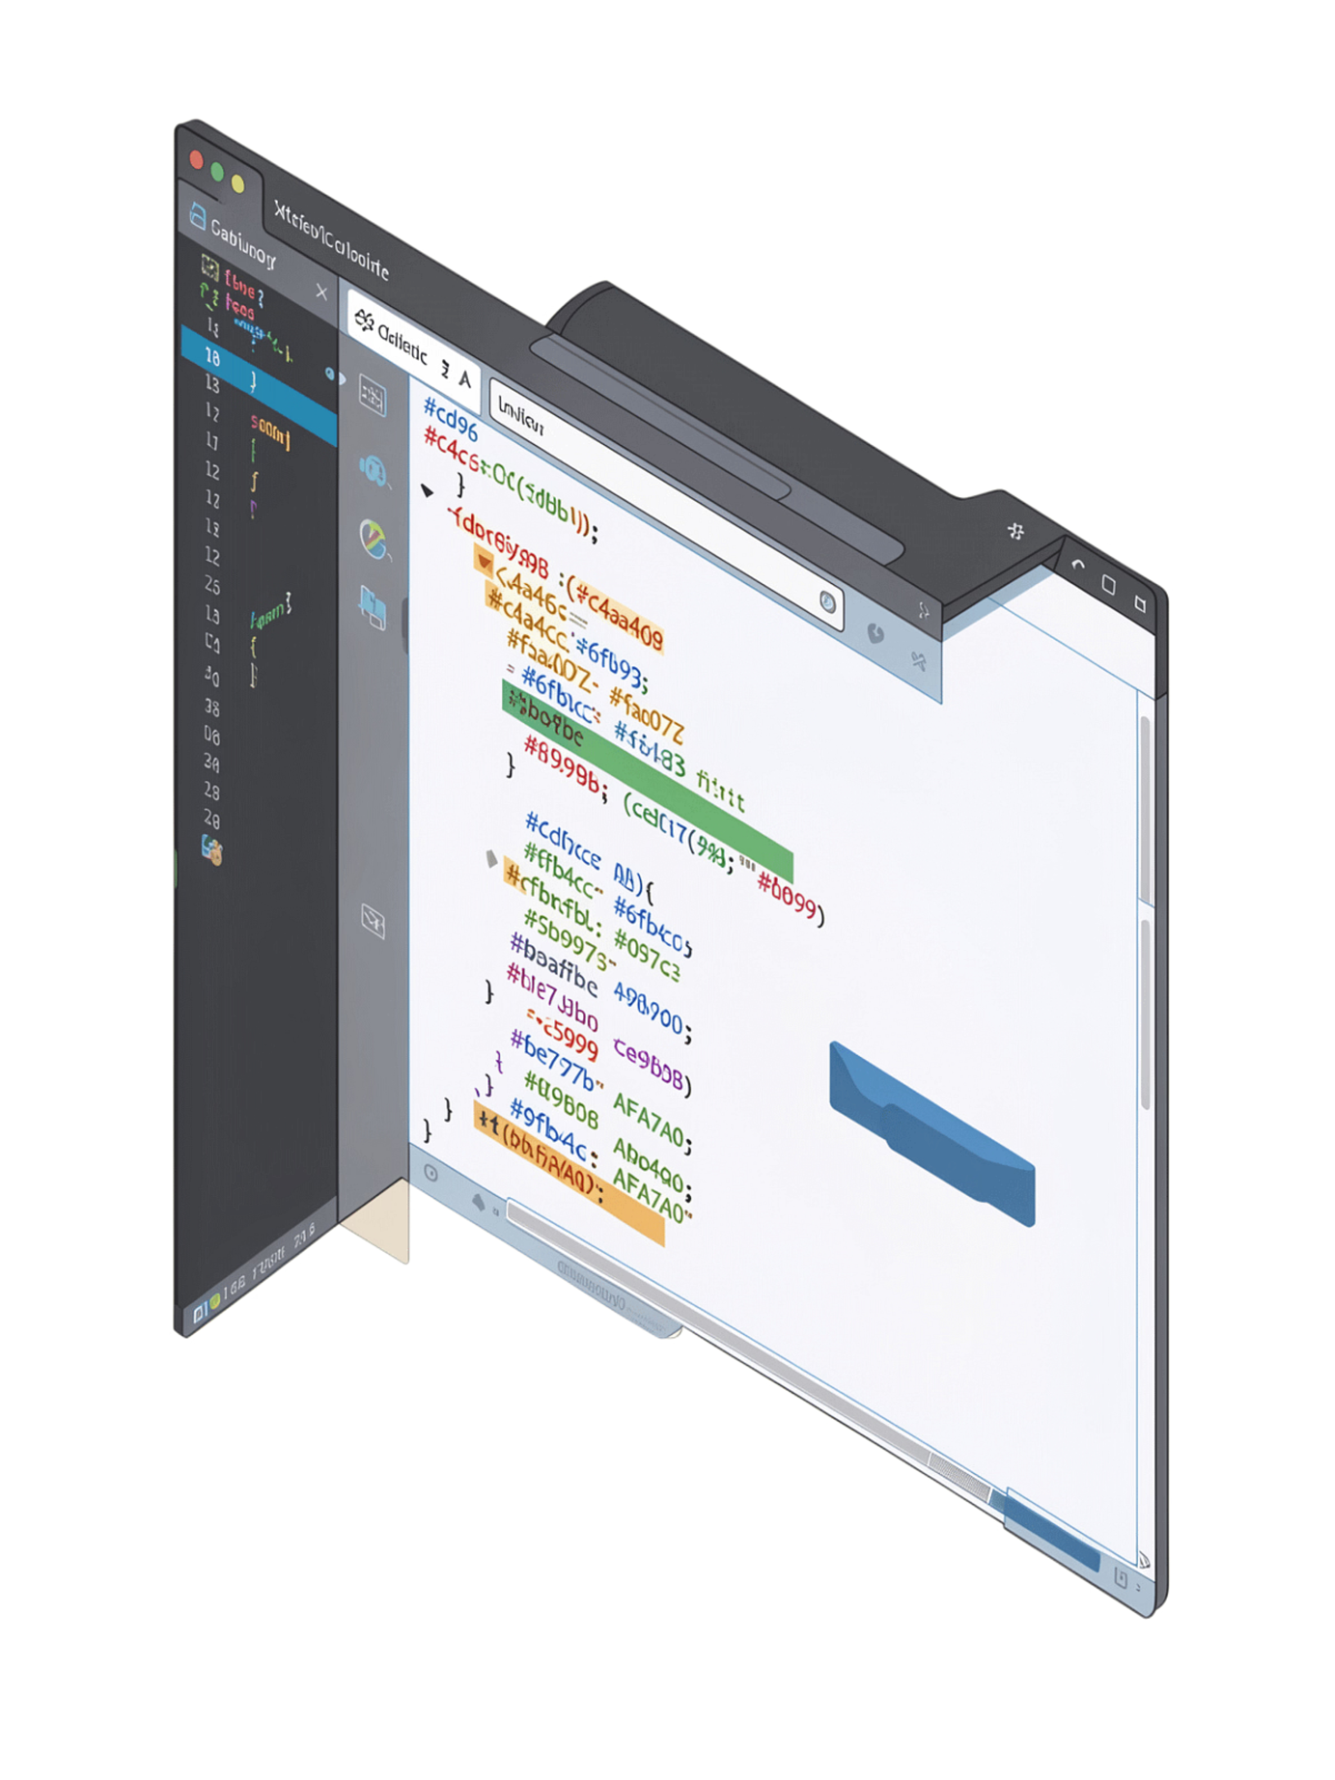
Step 5: Add Tasks to deno.json
Register two tasks in your deno.json file so you can run your app and initialize your database with simple commands:
{ "tasks": {
"serve": "deno --watch --allow-env --allow-net=0.0.0.0:8000 --allow-ffi --allow-read --allow-write main.js",
"db:create": "deno --watch --allow-env --allow-net=0.0.0.0:8000 --allow-ffi --allow-read --allow-write ./app/tasks/db-create.js"
},
"imports": {
"@db/sqlite": "jsr:@db/sqlite@^0.13.0",
"@std/http": "jsr:@std/http@^1.1.3"
}
}
serve
Runs main.js with file-watching and all required permissions
db:create
Runs db-create.js to initialize or reset the database

Slide 7
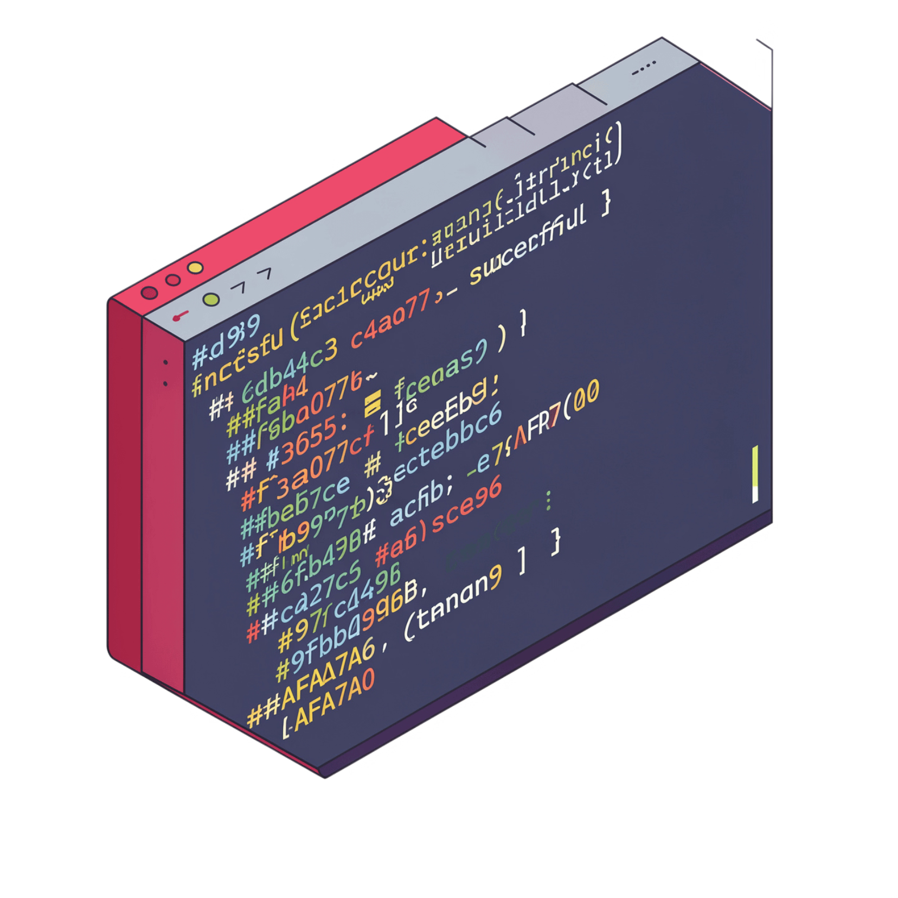

Step 6: Create Database & Table
With your tasks configured, run the following command in the terminal to create the students table and populate it with the initial sample data:
deno task db:create
After running this command, Deno will execute db-create.js, which will:
Drop any existing students table
Create a fresh table with the defined schema
Insert the sample records for Sudarshan and Mahadi
You can verify the result by opening studentsDB.db with the SQLite extension in VS Code.

Slide 8
Step 7: Create Read Model
In your models folder, create read.js. This module exports a function that queries all students from the database and returns them as an array.
1
Prepare
import { db } from '../db.js';
export default function readStudents() {
const query = db.prepare(
"SELECT * FROM students"
);
const students = query.all();
query.finalize();
return students;
}
Use db.prepare() to compile the SQL SELECT statement into a reusable query object
2
Execute
Call query.all() to run the query and retrieve all student rows as an array
3
Finalize
Call query.finalize() to free the prepared statement from memory

Slide 9
Step 8: Update home.js in Controllers
Wire everything together by updating home.js to call readStudents() and render the data as an HTML table with Edit/Delete actions. Then start your server:
// Controller
import render from "../render.js";
import homeView from "../views/home.js";
import readStudents from "../models/read.js";
export default function homeController(request){
const students = readStudents();
return render(()=>homeView(students))
}
Controller
View
Run
Call readStudents() and pass the result into the view renderer
Map each student to an HTML table row with Edit and Delete action links
Start the server with deno --watch --allow-all main.js and visit your home page

Slide 10
Step 9: Update home.js in views
The home.js view is responsible for taking the student data and rendering it into a well-structured HTML table, complete with action links for editing and deleting records. Below is the full view code, followed by a breakdown of its key components.
// View (app/views/home.js)
export default function homeView(students) {
const rows = students.map(student =>
`<tr>
<td>${student.id}</td>
<td>${student.name}</td>
<td>${student.phone}</td>
<td>${student.email}</td>
<td>${student.program}</td>
<td>${student.country}</td>
<td><a href="/update?id=${student.id}">Edit</a>
<a href="/delete?id=${student.id}">Delete</a></td>
</tr>`
).join('');
return `<table>
<thead>
<tr>
<th>ID</th>
<th>Name</th>
<th>Phone</th>
<th>Email</th>
<th>Program</th>
<th>Country</th>
<th>Actions</th>
</tr>
</thead>
<tbody>
${rows}
</tbody>
</table>`;
}
Dynamic Rows
Action Links
HTML Structure
The students.map() function iterates over each student record to generate an HTML <tr> (table row) with corresponding <td> (table data) cells.
Each student row includes "Edit" and "Delete" links, dynamically pointing to specific routes using the student's id.
The generated rows are embedded within a standard <table>, including <thead> for headers and <tbody> for data, ensuring proper semantic markup.

Slide 11
Step 10: Style Your Table
Add the following CSS to your style.css file to style your student table with borders, proper spacing, and centered alignment:
table, th, td {
border: 1px solid black;
border-collapse: collapse;
padding: 8px;
}
table {
margin: auto;
}
This styling will:
Borders
Collapse
Add borders around all table cells
Collapse borders to prevent double lines
Padding
Center
Add padding inside cells for better readability
Center the table on the page

Slide 12
Step 11: Run Your Application
Follow these final steps to see your student data displayed on the home page:
Step 12: Save all the files and in terminal run this command:
deno --watch --allow-all main.js
Step 13: Data from students table will be displayed on home page.
Your application is now complete! The students table data will be fetched from the SQLite database and rendered as an HTML table on your home page with all the styling you added.

